Slide 1
Pneumonia Detection using Convolutional Neural Network
Gopireddy Lakshmi Keerthi (Student ID: 11653876) LakshmiKeerthiGopireddy@my.unt.edu Major: Artificial Intelligence
Indhu Sri Krishnaraj (Student ID: 11661746) IndhuSriKrishnaraj@my.unt.edu Major: Artificial Intelligence
Vishal Rachuri (Student ID: 11658243) vishalrachuri@my.unt.edu Major: Artificial Intelligence
Jyothika Vollireddy (Student ID: 11652684) jyothikavollireddy@my.unt.edu Major: Cyber Security
Pavani Jaya Keerthana Chittedi (Student ID: 11672192) pavanijayakeerthanchittedi@my.unt.edu Major: Cyber Security

Slide 2
Introduction
Aim: Predict whether a person has Pneumonia or not from their chest X-ray
Motivation:
We have heard about multiple respiratory problems during and post covid situations
Pneumonia is one of the severe respiratory infection that can have serious consequences, especially for vulnerable populations such as children and elderly individuals
Early and accurate detection of pneumonia is crucial for timely intervention and effective treatment
Traditional methods for pneumonia diagnosis:
Using chest X-rays and clinical examinations,
Time-consuming and costly
Leveraging Convolutional Neural Networks (CNNs), a type of machine learning model, for pneumonia detection from chest X-rays can help in faster diagnosis and is cost-effective
Why CNN? CNNs is known to learn complex patterns from images

Slide 3
Data Description
Data type: Images in jpeg format
Data size: 1.16 GB
Training Data:
Chest X-rays of normal patients: 1341
Chest X-rays of Pneumonia patients: 3875
Test Data:
Chest X-rays of normal patients: 234
Chest X-rays of Pneumonia patients: 390
Validation Data:
Only 16 images in original dataset
Using 15% of training data for validation

Slide 4
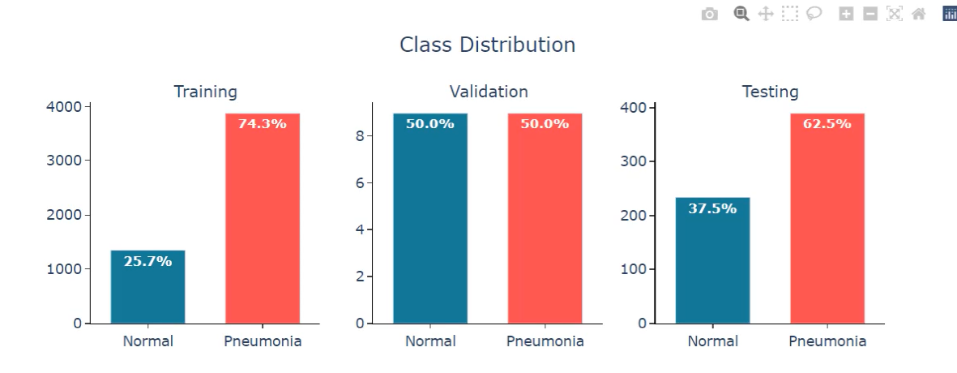
Dataset Distribution - Original Dataset as given in Kaggle

Slide 5
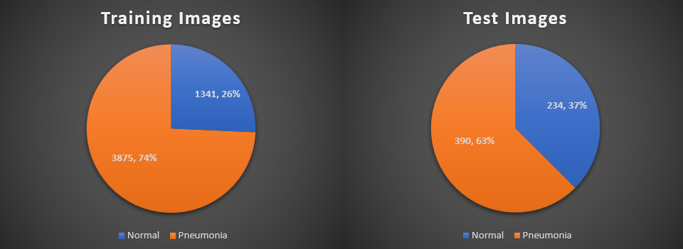
Dataset Distribution - Considering only training and testing images
*Validation data is 15% of the training data

Slide 6
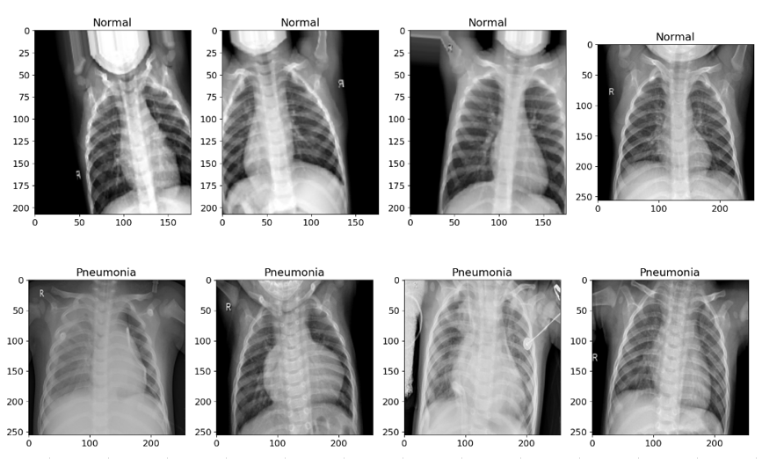
Sample Images of Chest X-Rays

Slide 7
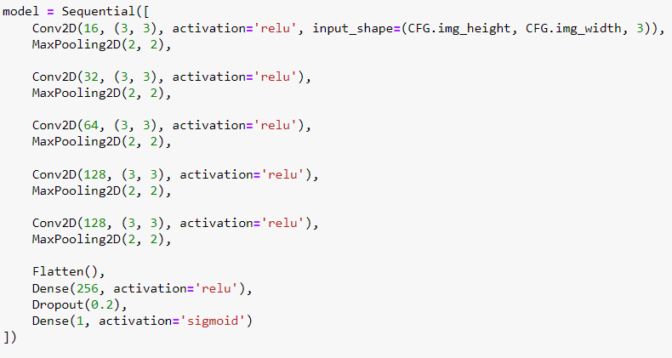
Model Training using Convolutional Neural Network
Model was trained using Convolutional Neural Network
2D convolutional operation and ReLU activation function is used in each layer followed by max pooling for spatial reducing dimensions
Number of filters in each layer: [16, 32, 64, 128, 128]

Slide 8
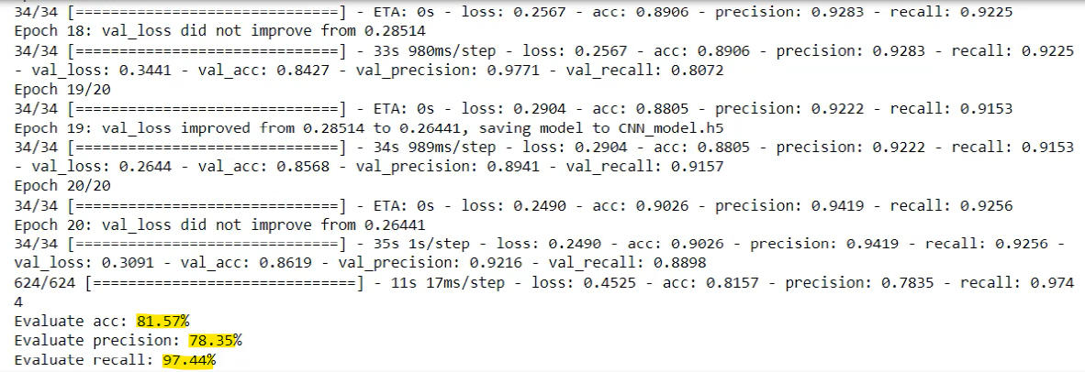
Model Training
Validation and test metrics are available as above

Slide 9
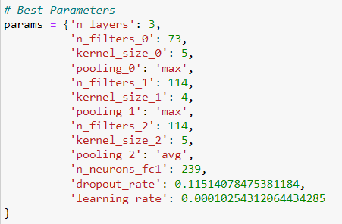
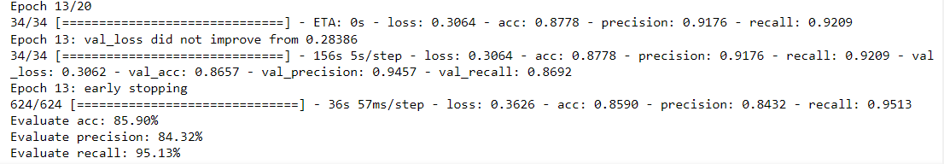
Hyperparameter Tuning and Activated Early Stopping
Validation and test metrics are available as above

Slide 10
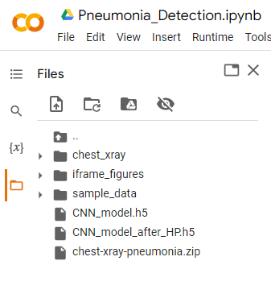
Model Saving
Model is saved with .h5 extension
.h5 extension indicates Hierarchical Data Format 5 File
We have saved two models,
CNN model without hyperparameter tuning
CNN model without hyperparameter tuning and early stop

Slide 11
Model Deployment
Using the model after hyperparameter tuning and enabling early stop as the final model
Deploying to a local webpage using Streamlit
Streamlit is a python-based library for creating web apps
CNN Model
INPUT
IMAGE
(Chest X-Ray)
Prediction
(Normal or Pneumonia)

Slide 12
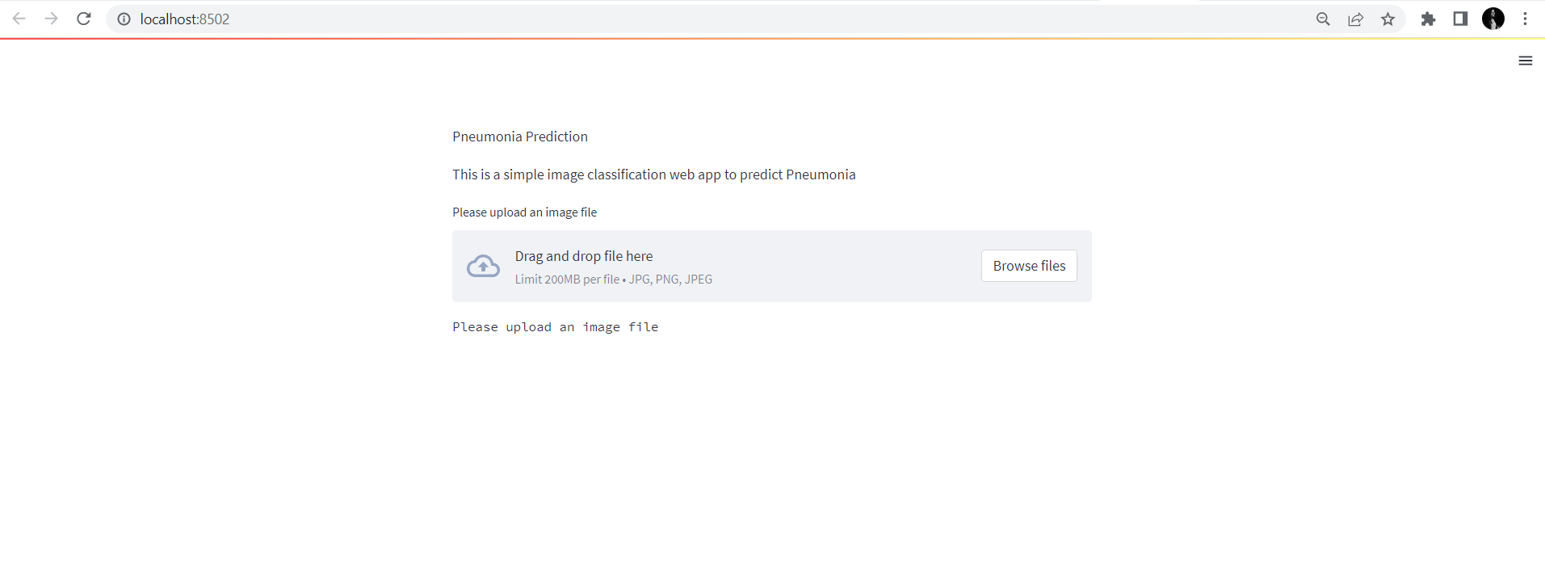
Model Deployment: Input Page
Input should be an image (Chest X-Ray) in .jpg or .png or .jpeg formats

Slide 13
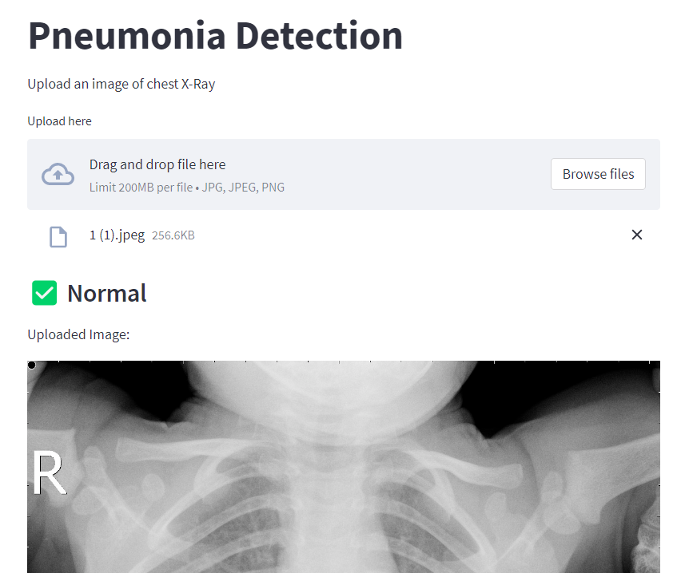
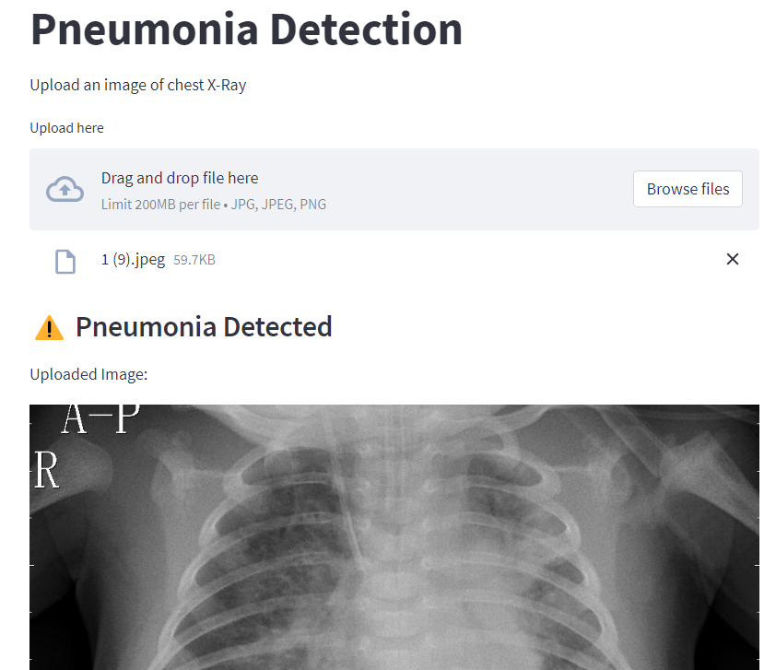
Model Deployment: Output Page
Output i.e., prediction made by the model is displayed above the image

Slide 14
THANK YOU!

